Slide 1
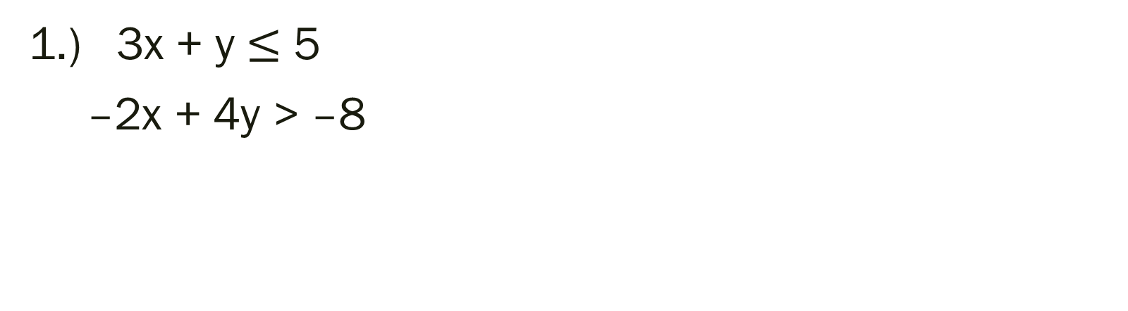
Bell Work: Solve the system of inequalities
1.) 3x + y $≤$ 5
–2x + 4y > –8

Slide 2
From Last Time
Page 179 #2, 3, 9, 11, 12, 19, 25, 27, 33
Mixed Review Page 181 #51, 54

Slide 3
ALGEBRA 3
Day 27

Slide 4

Quiz 1 Level 2: Solve the System
$1.) 6x+3y=75$
$$3y=21$$
$$2.) 2x−3y=−12$$
$3x+6y=24$

Slide 5

Quiz 1 Level 3: Solve the following
$3.) 4x+2y=8$
$$y+2x=4$$
$4.) 2x+y<3$
$x−y>6$ (Hint: you need to graph this)

Slide 6
Quiz 1 Level 4: Set up and Solve a System of Equations
5.) A sporting goods store receives a shipment of 124 golf bags. The shipment includes two types of bags, full-size and collapsible. The full-size bags cost $38.50 each. The collapsible bags cost $22.50 each. The bill for the shipment is $3430. How many of each type of golf bag are in the shipment?

Slide 7
Objective: To solve a system using a matrix

Slide 8
3.6 Solving Systems Using Matrices
Matrix: a rectangular array of numbers
Matrix Element (entry): the numbers that make up the rows and columns of a matrix
Dimensions: rows by columns

Slide 9
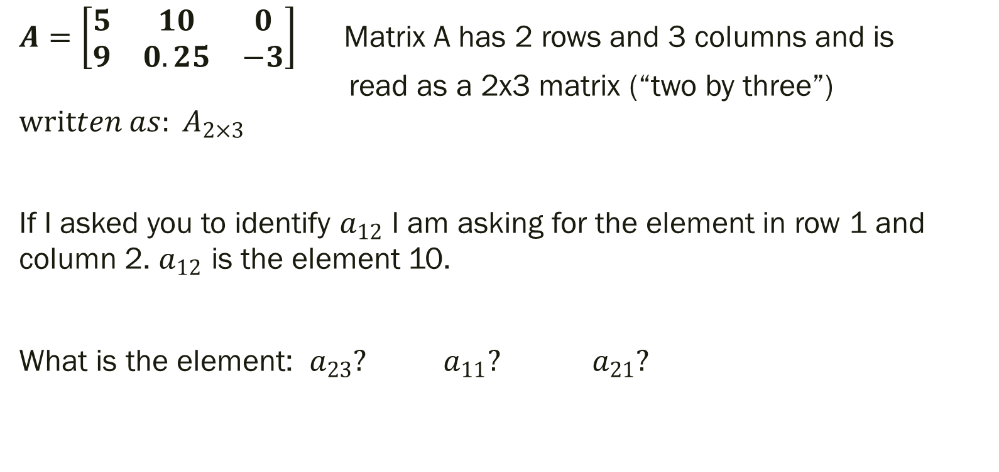
Example 1 of Identifying a Matrix Element:
$A=\left[\begin{matrix}5 & 10 & 0 \\ 9 & 0.25 & −3\end{matrix}\right]$ Matrix A has 2 rows and 3 columns and is read as a 2x3 matrix (“two by three”) $written as: A_{2×3}$
If I asked you to identify $a_{12}$ I am asking for the element in row 1 and column 2. $a_{12}$ is the element 10.
What is the element: $a_{23}?$ $a_{11}?$ $a_{21}?$

Slide 10

Using Matrices to Represent Systems of Equations
1.)
$$2x−y=4 \left[\begin{matrix}2 & −1 & 4 \\ 1 & 3 & 11\end{matrix}\right]$$ $x+3y=11$
$$x+y +2z=3$$
$2x+y+3z=7$ $\left[\begin{matrix}1 & 1 & 2 \\ 2 & 1 & 3 \\ −1 & −2 & 0\end{matrix}\right]\left[\begin{matrix}3 \\ 7 \\ 10\end{matrix}\right]$
$−x−2y =10$
2.)

Slide 11
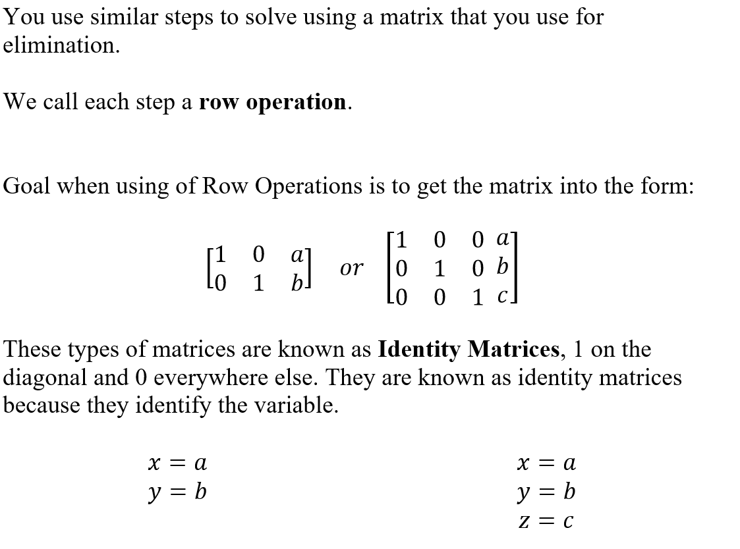
Solving a System Using a Matrix

Slide 12
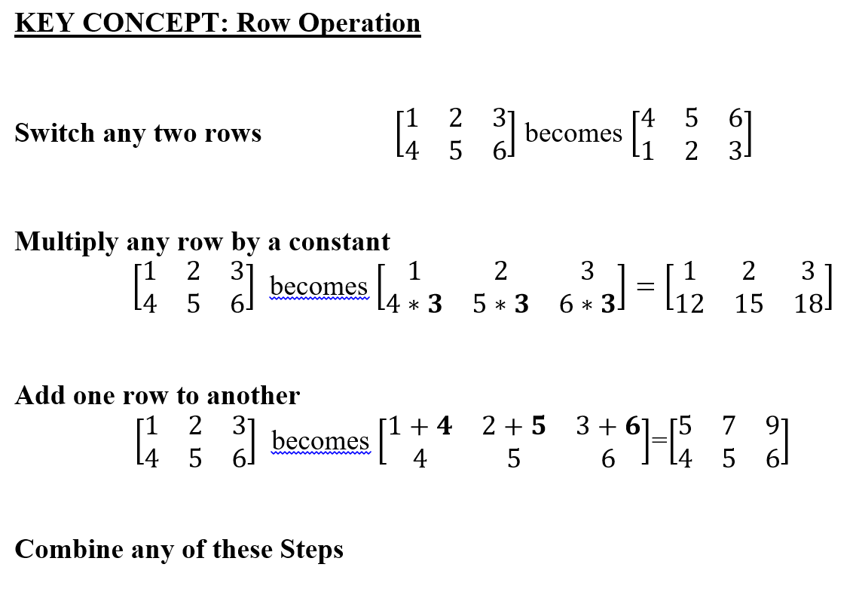

Slide 13
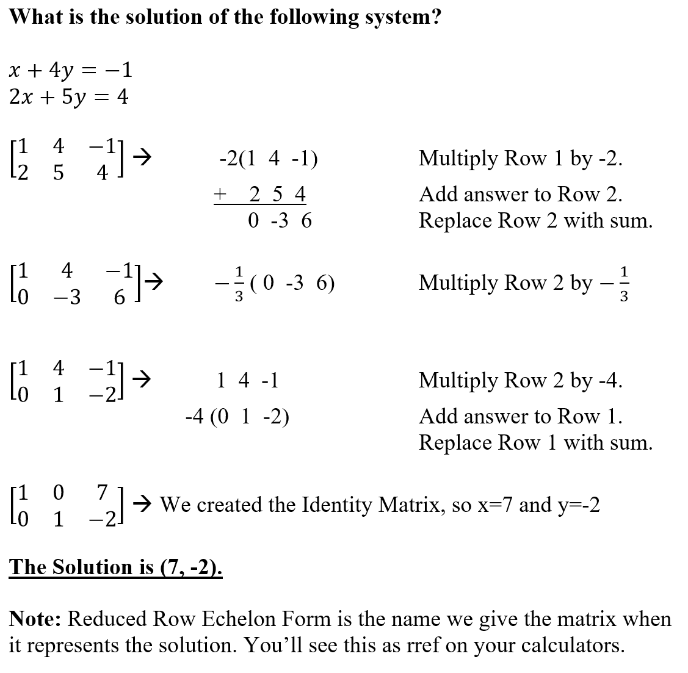

Slide 14
For Next Time
Page 153 #19, 23, 55, 66, 67, 72
Page 179 #7, 10, 17, 23, 24, 29

